Slide 1
Tuning Protocol
BY: jessica trelstad
1st grade -- Harriet bishop elementary

Slide 2
Context for Learning
I completed my student teaching in the Rochester Public School District in 1st Grade at Harriet Bishop Elementary. The class that I taught consisted of 21 students ages 6 or 7. Although the majority of the class was white, it was a diverse classroom with students coming from different social-economic backgrounds and ethnicities.

Slide 3
Context for Learning
Category | Number of Students
Class total | 21
Gender | Female: 11 Male: 10
IEPs | 2
Els | 2
SES | 6
Struggling readers | 5

Slide 4
Planning: The Calendar Lesson
Standard: Count, compare, and represent numbers up to 120, with an emphasis on groups of tens and ones.
Benchmarks:
1.1.1.2 Read, write and represent whole numbers up to 120. Representations may include numerals, addition and subtraction, pictures, tally marks, number lines and manipulatives, such as bundles of sticks and base 10 blocks.
1.1.1.5 Compare and order whole numbers up to 120.

Slide 5
Planning: The Calendar Lesson
Content Objectives:
Students will be able to count forward by 1s.
Students will be able to record ordered whole numbers
Students will be able to use a calendar to answer questions about the days of the week, months of the year, and the date.
Language Objective:
Students will be able to orally state the current date using the provided sentence frame.

Slide 6
Planning: The Calendar Lesson
Assessment
Formative
Questioning and discussion
Observation
Visual representation
Materials
Math Journal 1, p. 4

Slide 7
Planning: Flow of Lesson
Dance preview
Calendar discussion
Constructing individual calendars
Closing

Slide 8
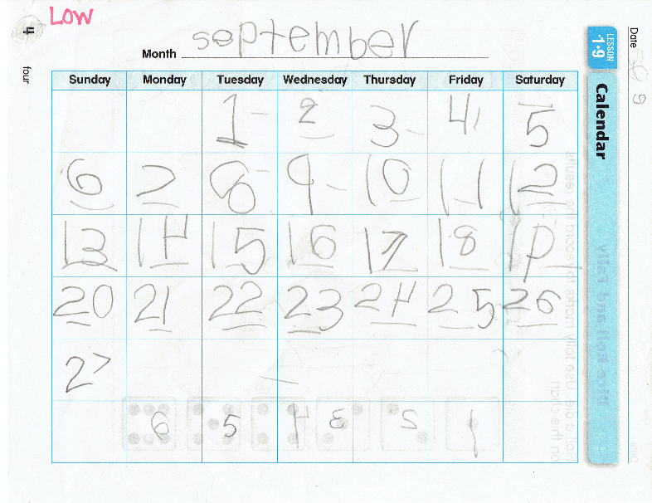
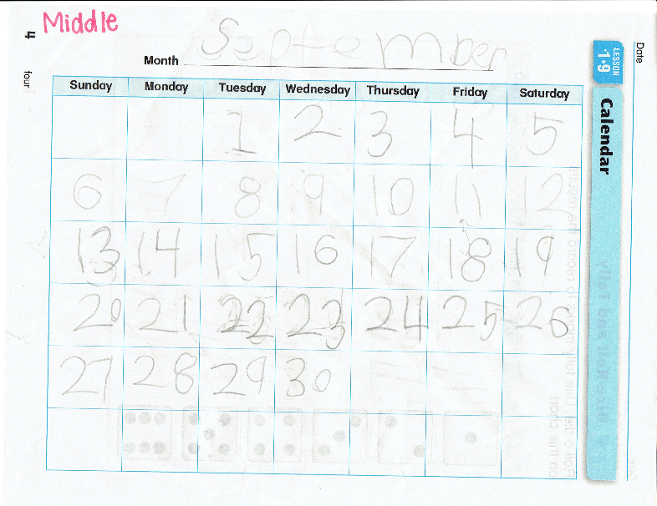
Student Work

Slide 9
Focus Question
How is the teacher instruction reflected in the student work?
https://youtu.be/Ak5AfmkopJM

